Slide 1
Contacts Dictionary By: Kuppam Haritha Chaithanya Badepalli Jyothipriya Manchala Bommasani Pavithra Manasa Sadum Guided by:- Aliasgar Mulla

Slide 2
Introduction: Aim:- The aim of this project is to implement the dictionary of contacts in which the user stores the all personal and business contact. This project includes contactid, name, mobilenumber, emailid, address, whatsappnumber,emergency contact, designation, company name. Intendended Audiance:- This application is intended to be use by user. Inteded Use: 1. Development Team 2. Maintenance Team 3. Admin 4. User

Slide 3
Purpose: 1. The purpose of this project is to develop the contacts dictionary in which the user can store all personal and business contacts. It enables the user to add contact and list the all personal and business contacts. and i t enables the Admin to delete, update and lists all personal and business contacts. 2. This application stores all attributes of all personal and business contacts.

Slide 4
Functions:
void options():
This function is responsible for to show options on the screen.
void clear():
This function is responsible to clear the screen.
int admin():
This function is responsible for admin credentials.
void admin_menu():
This function shows menu for the admin.

Slide 5
User Functions:
int user _reg():
This function is responsible for user registration.
int user_login():
This function is responsible for user login.
void user_menu():
This function shows the user menu.
void add_new_contact():
This function is responsible for adding new contacts by the user.

Slide 6
Validation Functions:
int val_name():
This function is responsible to check whether the name is valid or not.
int val_mobileno():
This function is responsible to check whether the mobileno is valid or not.
int val_emailid():
This function is responsible to check whether the emailid is valid or not.
int val_emergency contact():
This function is responsible to check whether emergency contact is valid or not.

Slide 7
Functions:
void delete_personal():
This function is responsible to delete personal contact.
void delete_business():
This function is responsible to delete business contact.
void update_personal():
This function is responsible to update personal contact.
void update_business():
This function is responsible to update business contact.
void display_contact_options():
This function is responsible to display contact options.
void list_all_personal_contacts():
This function is responsible for listing all personal contacts.
void list_all_business_contacts():
This function is responsible for listing all business contacts.

Slide 8
Structure:
struct users
{
char uname[Max];
char pword[Max];
struct users *link;
};
This structure stores the username and password for users.

Slide 9
Structure(personal contacts):
struct personal
{
int contactid;
char firstname[Max];
char lastname[Max];
char mobileno1[Max];
char mobileno2[Max];
char emailid1[Max];
char emailid2[Max];
char address[Max];
char whatsapp_mb[Max];
char emergencycontact[Max];
struct personal *link;
};
This structure stores the attributes of the personal contacts.

Slide 10
Structure(business contacts):
struct business
{
int contactid;
char firstname[Max];
char lastname[Max];
char mobileno1[Max];
char mobileno2[Max];
char emailid1[Max];
char emailid2[Max];
char company[Max];
char designation[Max];
struct business *link;
};
In this we store the attributes of business contacts.

Slide 11
Admin: Admin can directly login to the application with the password “Admin”. Admin can delete, update and list all the personal and business contacts.

Slide 12
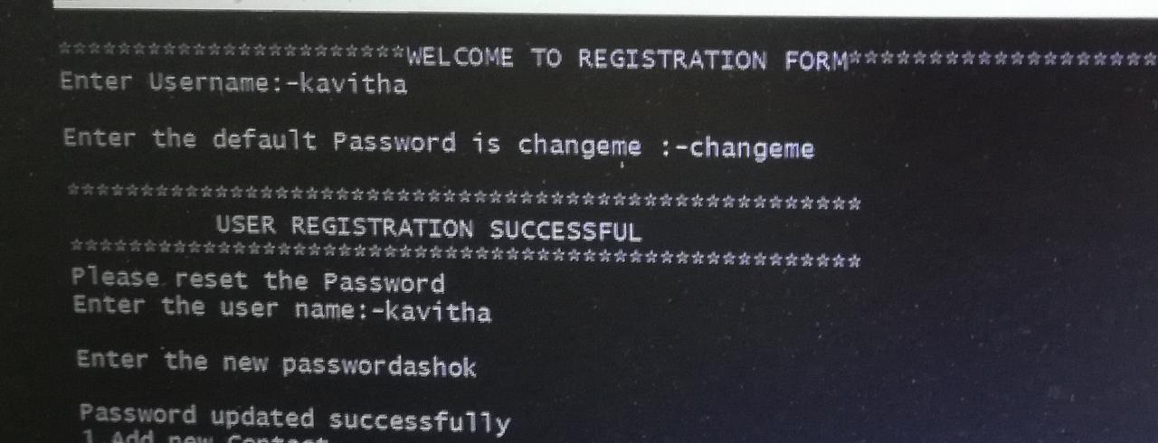
New User Registration: New User need to register first with username and default password (changeme) before login to the application. After login to the application users have to reset their password.

Slide 13
Login Success: While user logins to the application user need to enter the password if the user entered password is matched with password stored in users.txt file then user logins to the app successfully. Login Failure: While user logins to the application if the user entered password doesnot match with the password stored in users.txt file then the user fails to login the application.

Slide 14
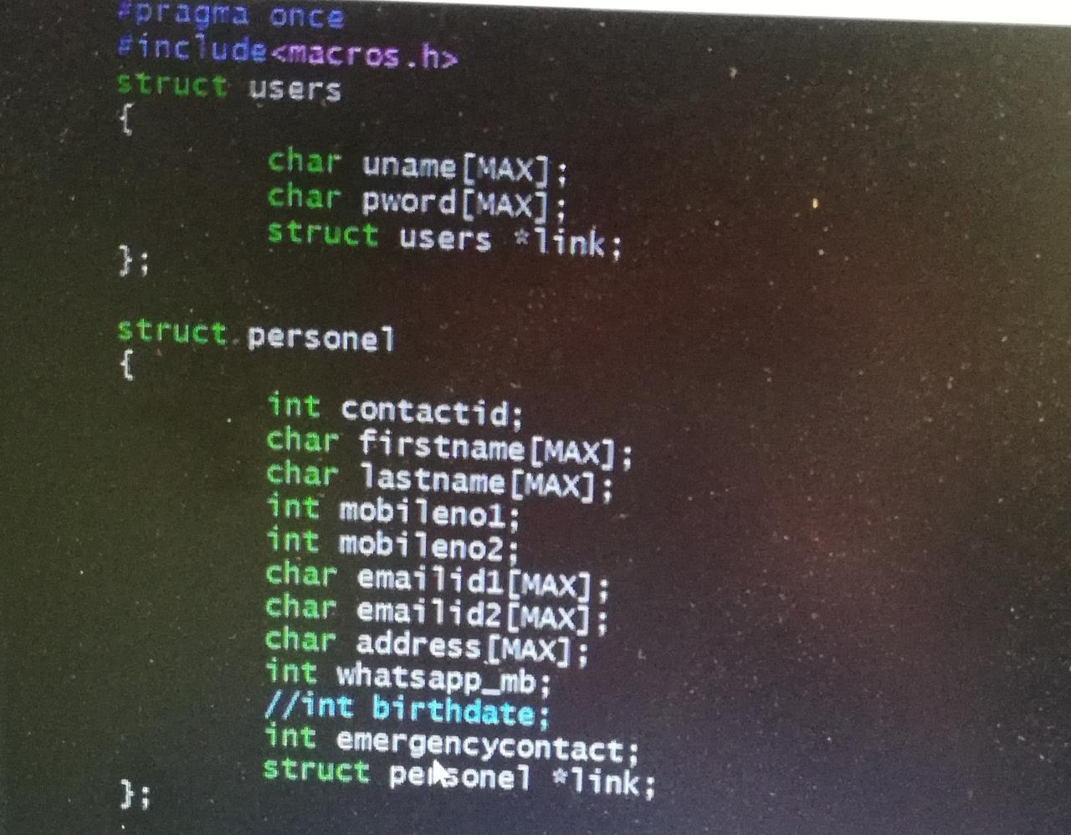
Personal Contacts: In this application personal contacts are stored in “personal.txt” file with the following attributes 1. contactid 2. first name 3. last name 4. mobile number 5. emailid 6. address 7. whatsapp number 8. emergency contact

Slide 15
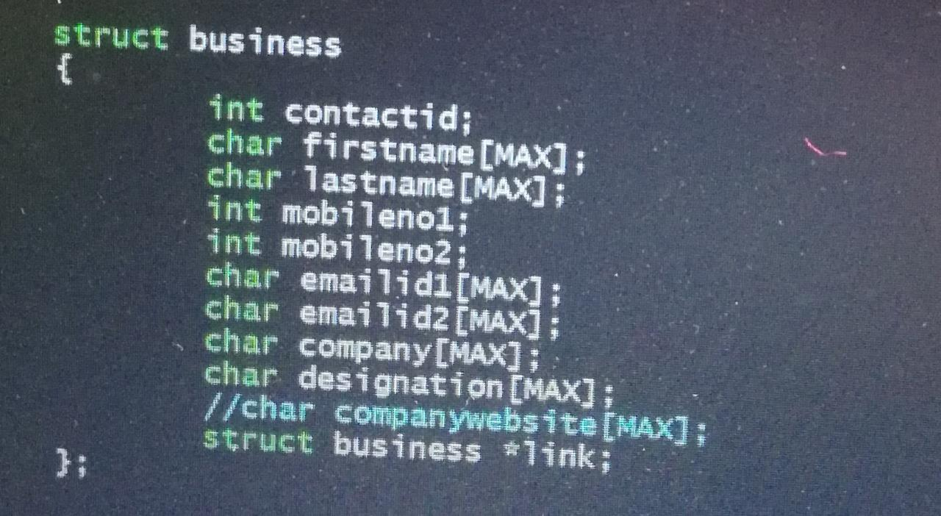
Business Contacts: In this application business contacts are stored in “contact.txt” file with the following attributes 1. contactid 2. first name 3. last name 4. mobile number 5. emailid 6. company name 7. designation

Slide 16
Operations: Operations performing on contacts are: 1. Add new contact. 2. Update contact. 3. Delete contact. 4. List all personal contacts. 5. List all business contacts.

Slide 17
Add Contact: If user want to add contact user can add the contact. Update Contact: Only Admin can able to update the contacts. No other user is allowed to update the contact. Delete Contact: Only Admin can able to delete the contacts. No other users are allowed to update the contact.

Slide 18
List of Contacts: The user and admin after login to the application can able to display the list of both personal and business contacts.

Slide 19
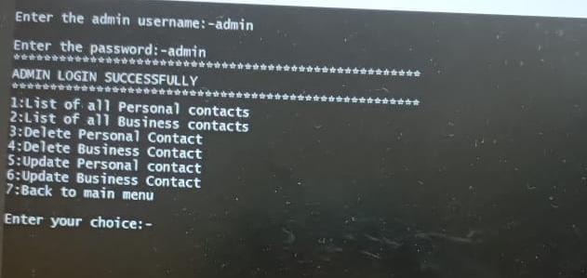
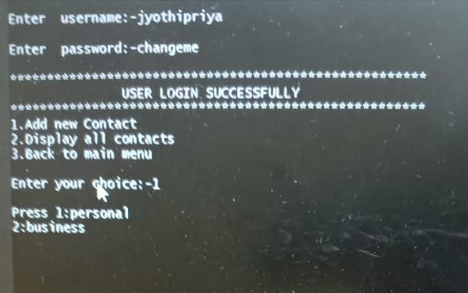

Slide 20
Non-Functional Requirements:
Tools to be used
Makefile:- It is a way of automating software building procedure and other complex tasks with dependencies.
It is a set of comands with variable names and targets to create object file and to remove them.
Valgrind:- Valgrind is a programming tool for memory debugging, memory leakage detection and profiling.
Ctags:- Ctags tool is used to navigate between the files.

Slide 21
Conclusion:
The purpose of this application was to store the attributes of all personal and business contacts and it enables the add, delete, update and list all personal and business contacts operations to be performed on the contacts.

Slide 22


